Slide 1

Unit 3-Computer Arithmetic
The arithmetic and logic Unit.
Integer representation.
Integer arithmetic.
Floating point representation.
Floating point arithmetic.
Introduction of arithmetic co-processor.

Slide 2
The arithmetic and logic Unit
ALU perform actual arithmetic and logical operation on data.
All of the other elements of the computer system—control unit, registers, memory, I/O—are there mainly to bring data into the ALU for it to process and then to take the results back out.
All electronic components in the computer, are based on the use of simple digital logic devices that can store binary digits and perform simple Boolean logic operations.
Operands for arithmetic and logic operations are presented to the ALU input.
Results of an operation are stored in temporary registers.
The ALU also set/Reset flags ( update Flag Register) as the result of an Arithmetic/Logical operation.

Slide 3
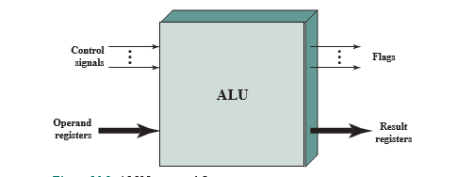
The arithmetic and logic Unit
ALU Connections

Slide 4
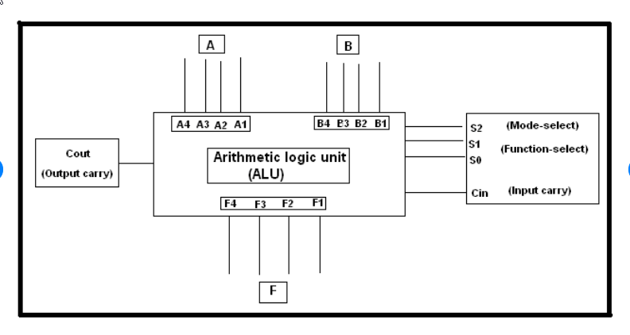
The arithmetic and logic Unit
ALU Block Diagram:

Slide 5
The arithmetic and logic Unit
How Digital Circuit is implemented inside ALU?
Which Components are used ?
What is the method to design those circuits?
Lets Take an example of simple adder …which can add two bit of data ……A and B
1. Truth table are developed
2. Boolean Equations are formed .
3. Boolean equations are implemented using logic gates.

Slide 6
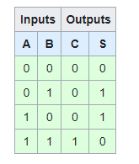
The arithmetic and logic Unit
1. Truth table are developed as per requirement.
2. Boolean Equations are formed .
3. Boolean equations are implemented using logic gates.

Slide 7
The arithmetic and logic Unit
1. Truth table are developed
2. Boolean Equations are formed .
3. Boolean equations are implemented using logic gates.
Sum = a EX OR b
Carry = a AND b

Slide 8
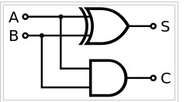
The arithmetic and logic Unit
1. Truth table are developed
2. Boolean Equations are formed .
3. Boolean equations are implemented using logic gates.

Slide 9
The arithmetic and logic Unit
Similarly all arithmetic and logical circuits are implemented inside ALU..
Such as .. Adder ( 8 Bit…16 bit ..as per the required size)
Subtractor
multiplier
divider
logical circuits and many more ……..

Slide 10
Integer representation:
For purposes of computer storage and processing, we do not have the benefit of special symbols for the minus sign and radix point.
Only binary digits (0 and 1) may be used to represent numbers.
If we are limited to nonnegative integers, the representation is straightforward.
An 8-bit word can represent the numbers from 0 to 255, such as,
00000000 = 0
00000001 = 1
00101001 = 41
10000000 = 128
11111111 = 255

Slide 11
Integer representation:
Then How to represent NEGATIVE numbers in computer ?
There are several alternative conventions used to represent negative as well as positive integers,.
All of which involve treating the most significant (leftmost) bit in the word as a sign bit.
If the sign bit is 0, the number is positive; if the sign bit is 1, the number is negative.

Slide 12
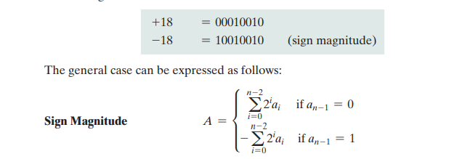
SIGNED-MAGNITUDE representation
The simplest form of representation that employs a sign bit is the sign-magnitude representation.
In an n-bit word, the leftmost bit (MSB) bits hold the Sign and remaining bits holds the magnitude of the integer.

Slide 13

Drawbacks of sign-magnitude representation:
Addition and subtraction require a consideration of both the signs of the numbers and their relative magnitudes to carry out the required operation.
There are two representations of 0
Because of these drawbacks, sign-magnitude representation is rarely used in implementing the integer portion of the ALU. Instead, the most common scheme is twos complement representation.

Slide 14
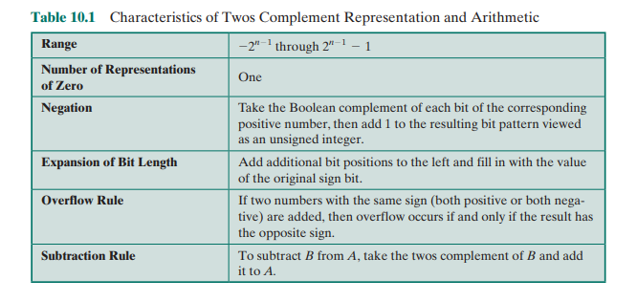
Two’s Complement Representation
Like sign magnitude, twos complement representation uses the most significant bit as a sign bit, making it easy to test whether an integer is positive or negative.
It differs from the use of the sign-magnitude representation in the way that the other bits are interpreted.

Slide 15
Two’s Complement Representation
The number zero is identified as positive and therefore has a 0 sign bit and a magnitude of all 0s.
Range of positive integers that may be represented is from 0 (all of the magnitude bits are 0) through 2^{n-1} - 1 (all of the magnitude bits are 1).
Example,
If n=4, then positive number will be from 0000 to 0111(0,1,2,3,4,5,6,7).
If n=3, then positive number will be from 000 to 011(0,1,2,3).
Now, for a negative number A(A < 0), the sign bit, a_{n-1} is one.
The remaining n - 1 bits can take on any one of 2^{n-1} values. Therefore, the range of negative integers that can be represented is from -1 to -^{2n-1}
Example,
If n=4, then negative number will be from 1000 to 1111(-8,-7,-6,-5,-4,-3,-2,-1).
If n=3, then negative number will be from 100 to 111(-4,-3,-2,-1).

Slide 16
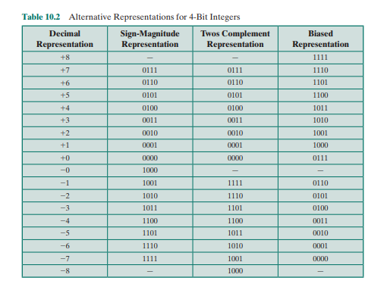
Two’s Complement Representation
2’s complement method facilitates the most important arithmetic operations, addition and subtraction. For this reason, it is almost universally used as the processor representation for integers.

Slide 17
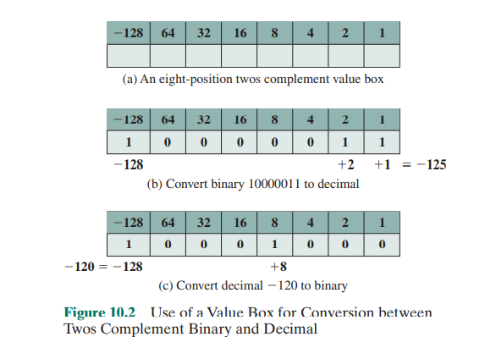
Two’s Complement Representation: Value Box

Slide 18
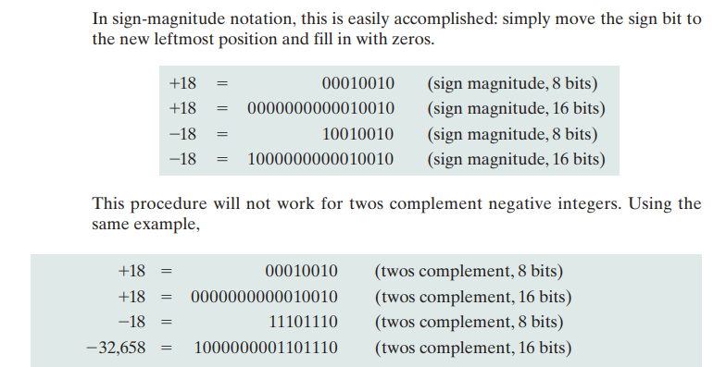
Two’s Complement Representation: Range Extension
Range Extension It is sometimes desirable to take an n-bit integer and store it in m bits, where m > n.
This expansion of bit length is referred to as range extension, because the range of numbers that can be expressed is extended by increasing the bit length.

Slide 19

Two’s Complement Representation: Range Extension
The rule for twos complement integers is to move the sign bit to the new leftmost position and fill in with copies of the sign bit.
For positive numbers, fill in with zeros, and for negative numbers, fill in with ones. This is called sign extension.
The representations discussed above is referred to as fixed point.
This is because the radix point (binary point) is fixed and assumed to be to the right of the rightmost digit.

Slide 20
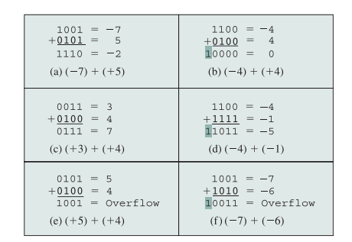
Integer Arithmetic: Addition and Subtraction
Overflow rule: If two numbers are added, and they are both positive or both negative, then overflow occurs if and only if the result has the opposite sign.
In some instances, there is a carry bit beyond the end of the word (indicated by shading), which is ignored.
Addition:

Slide 21
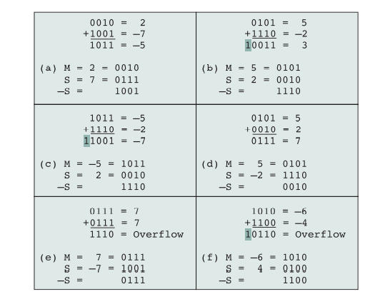
Integer Arithmetic: Addition and Subtraction
Subtraction rule: To subtract one number (subtrahend) from another (minuend), take the twos complement (negation) of the subtrahend and add it to the minuend.
Thus, subtraction is achieved using addition.

Slide 22
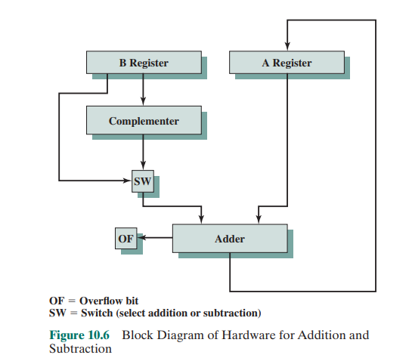
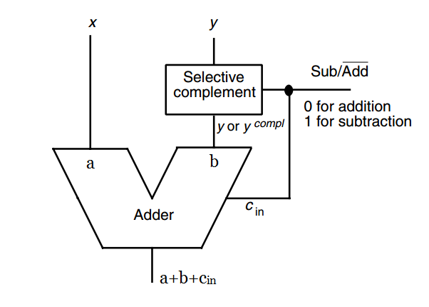
Integer Arithmetic: Hardware for Addition and Subtraction

Slide 23
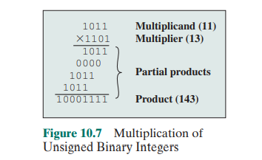
Integer Arithmetic: Multiplication- method
unsigned integers:
1. Partial product.
2 Shift Partial product.
3 Add partial product to get final result.
The multiplication of two n-bit binary integers results in a product of up to 2n bits in length (e.g., 11 * 11 = 1001).

Slide 24
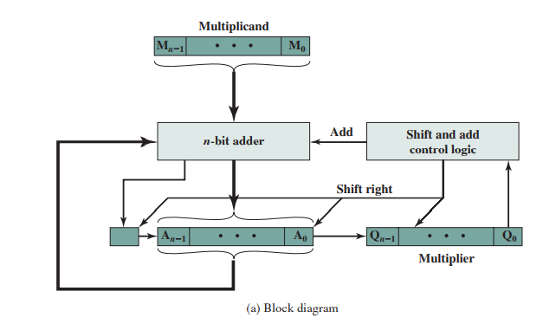
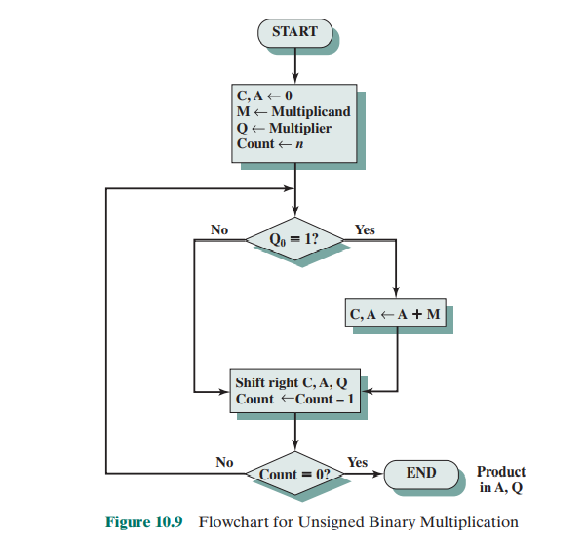
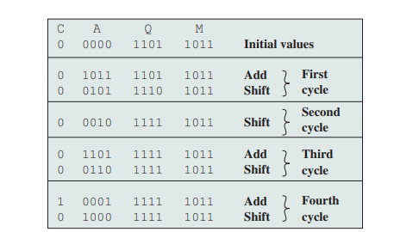
Integer Arithmetic: Multiplication-Implementation (H/W)

Slide 25
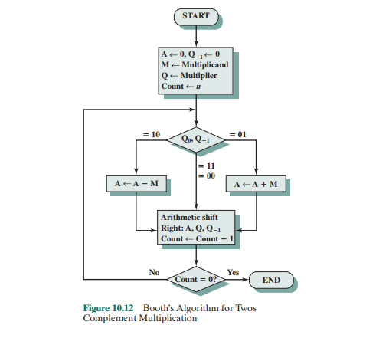
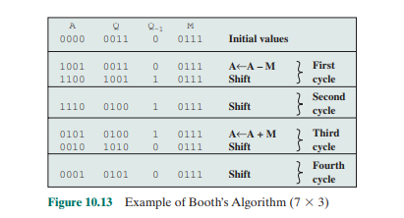
Integer Arithmetic: Multiplication-Booths Algorithm

Slide 26
Integer Arithmetic: Multiplication-Booths Algorithm
1-bit register placed logically to the right of the least significant bit (Q0) of the Q register and designated Q-1.
The results of the multiplication will appear in the A and Q registers
A and Q-1 are initialized to 0
control logic scans the bits of the multiplier one at a time. Now, as each bit is examined, the bit to its right is also examined.
If the two bits are the same (1–1 or 0–0), then all of the bits of the A, Q, and Q-1 registers are shifted to the right 1 bit.
If the two bits differ, then the multiplicand is added (0-1)to or subtracted(1-0) from the A register.
In any shift case, the right shift is such that the leftmost bit of A, namely An-1, not only is shifted into An-2, but also remains in An-1. This is required to preserve the sign of the number in A and Q. It is known as an arithmetic shift, because it preserves the sign bit.

Slide 27
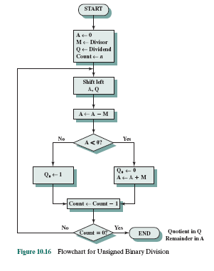
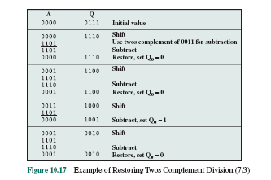
Integer Arithmetic: Division

Slide 28
Integer Arithmetic: Division
The divisor is placed in the M register, the dividend in the Q register.
At each step, the A and Q registers together are shifted to the left 1 bit.
M is subtracted from A to determine whether A divides the partial remainder.

Slide 29
An IEEE floating point representation consists of
A Sign Bit
An Exponent
Mantissa (“Significand”), which is assumed to be 1.xxxxx (thus, one bit of the mantissa is implied as 1)
This is called a normalized representation
So a mantissa = 0 really is interpreted to be 1.0, and a mantissa of all 1111 is interpreted to be 1.1111
Floating Point
Notes:
September 4, 1997
29

Slide 30
Floating Point Standard
Defined by IEEE Std 754-1985
Developed in response to divergence of representations
Portability issues for scientific code
Now almost universally adopted
Two representations
Single precision (32-bit)
Double precision (64-bit)

Slide 31
IEEE Floating-Point Format
single: 8 bits double: 11 bits
single: 23 bits double: 52 bits
S
Exponent
Fraction
S: sign bit (0 ⇒ non-negative, 1 ⇒ negative)
Normalize significand: 1.0 ≤ |significand| < 2.0
Always has a leading pre-binary-point 1 bit, so no need to represent it explicitly (hidden bit)
Significand is Fraction with the “1.” restored
Exponent: excess representation: actual exponent + Bias
Ensures exponent is unsigned
Single: Bias = 127; Double: Bias = 1203

Slide 32
Single-Precision Range
Exponents 00000000 and 11111111 reserved
Smallest value
Exponent: 00000001 Actual/True exponent = 1 – 127 = –126
Fraction: 000…00 means significand = 1.000….0000
±1.0 × 2^{–126}
Largest value
exponent: 11111110 Actual/True exponent = 254 – 127 = +127
Fraction: 111…11 means significand ≈ 2.0
±2.0 × 2⁺¹²⁷

Slide 33
Double-Precision Range
Exponents 0000…00 and 1111…11 reserved
Smallest value
Exponent: 00000000001 ⇒ actual/True exponent = 1 – 1023 = –1022
Fraction: 000…00 ⇒ significand = 1.0
±1.0 × 2^{–1022}
Largest value
Exponent: 11111111110 ⇒ actual/True exponent = 2046 – 1023 = +1023
Fraction: 111…11 ⇒ significand ≈ 2.0
±2.0 × 2⁺¹⁰²³

Slide 34
Representation of Floating Point Numbers
IEEE 754 single precision
31
30
23
22
0
Sign
Biased exponent
Normalized Mantissa (implicit 24th bit = 1)
(-1)^{s} × F × 2^{E-127}
Notes:
September 4, 1997
34

Slide 35
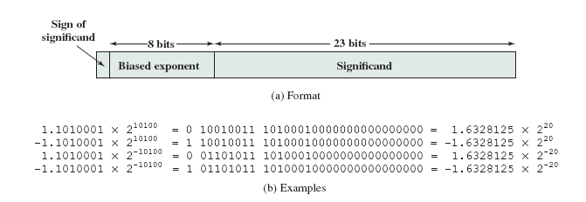
Floating-Point Example
Represent –0.75
–0.75 = (–1)¹ × 1.1₂ × 2^{–1}
S = 1
Fraction = 1000…00₂
Exponent = –1 + Bias
Single: –1 + 127 = 126 = 01111110₂
Single(32 Bit): 1011111101000…00

Slide 36
Floating-Point Addition (Decimal Add/Sub examples)
Consider a 4-digit decimal example
9.999 × 10¹ + 1.610 × 10^{–1}
1. Align decimal points
Shift number with smaller exponent
9.999 × 10¹ + 0.016 × 10¹
2. Add significands
9.999 × 10¹ + 0.016 × 10¹ = 10.015 × 10¹
3. Normalize result & check for over/underflow
1.0015 × 10²
4. Round and renormalize if necessary
1.002 × 10²

Slide 37
Floating-Point Addition (Binary add/Sub example)
Now consider a 4-digit binary example
1.000₂ × 2^{–1} + –1.110₂ × 2^{–2} (0.5 + –0.4375)
1. Align binary points
Shift number with smaller exponent
1.000₂ × 2^{–1} + –0.111₂ × 2^{–1}
2. Add significands
1.000₂ × 2^{–1} + –0.111₂ × 2–1 = 0.001₂ × 2^{–1}
3. Normalize result & check for over/underflow
1.000₂ × 2^{–4}, with no over/underflow
4. Round and renormalize if necessary
1.000₂ × 2^{–4} (no change) = 0.0625

Slide 38
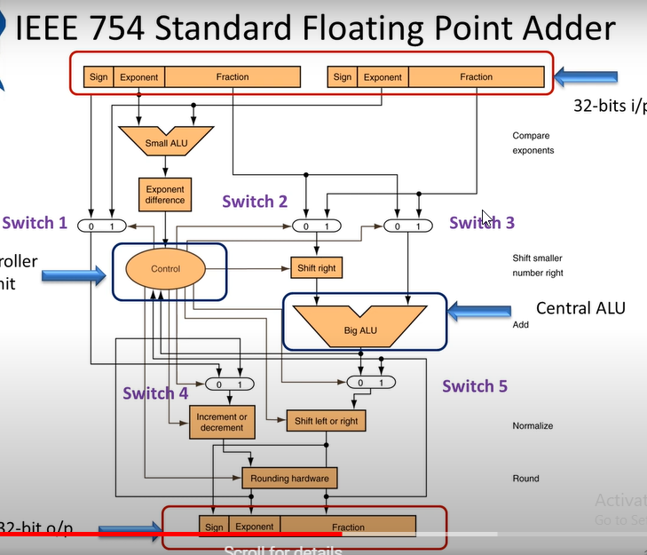
Notes:
September 4, 1997
38

Slide 39
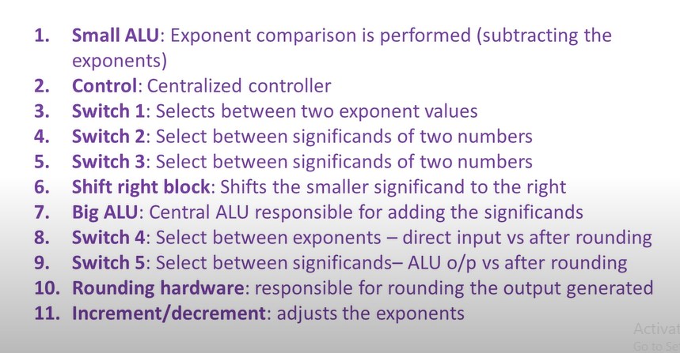
Floating point addition/Subtraction
Notes:
September 4, 1997
39

Slide 40
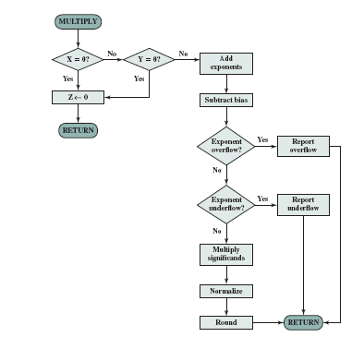
Floating point Multiplication
Notes:
September 4, 1997
40

Slide 41
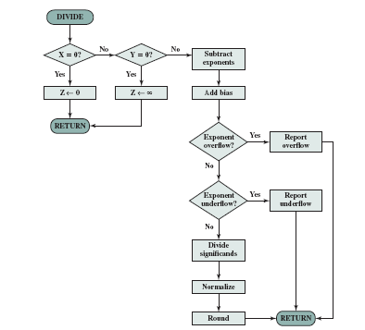
Floating point Division
Notes:
September 4, 1997
41

Slide 42
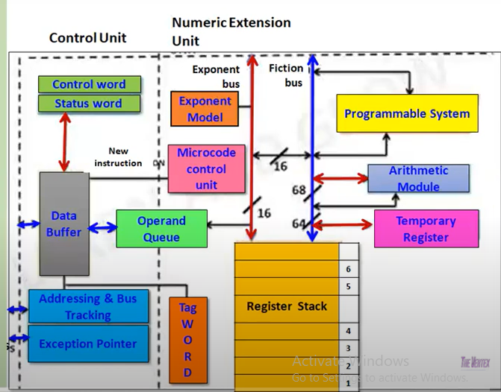
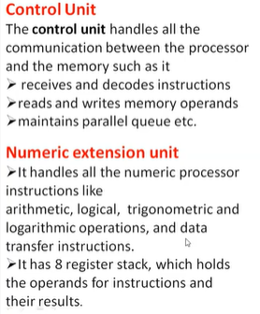
8087 Co Processor( FPU)
Notes:
September 4, 1997
42

Slide 43
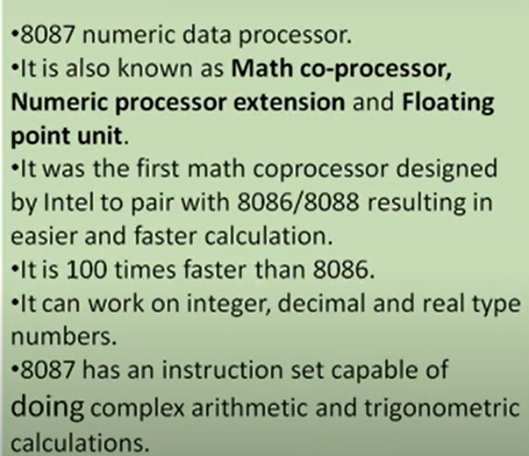
8087 Co Processor( FPU) features:
Notes:
September 4, 1997
43

Slide 44
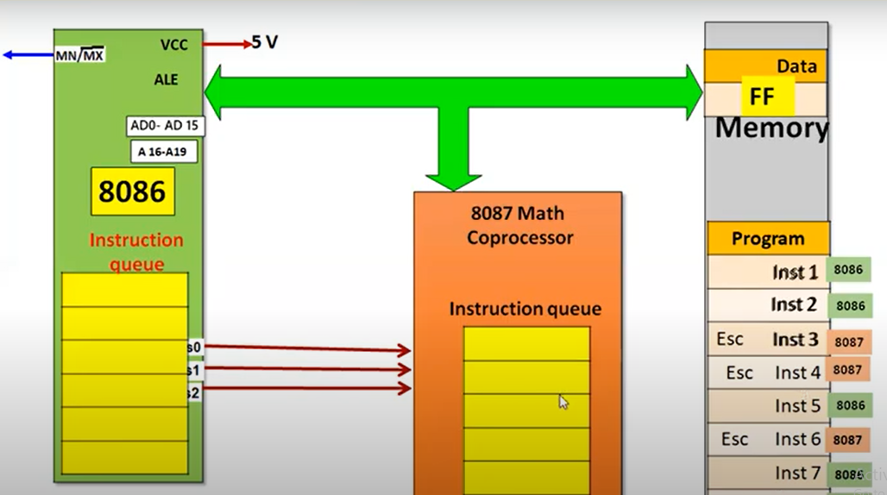
8087 Co Processor( FPU) : Its own instruction set
Notes:
September 4, 1997
44

